Slide 1

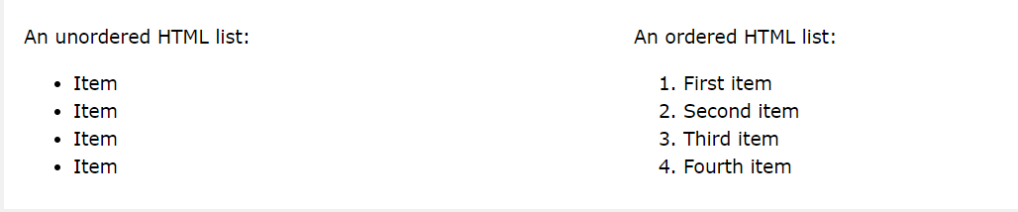

Slide 2
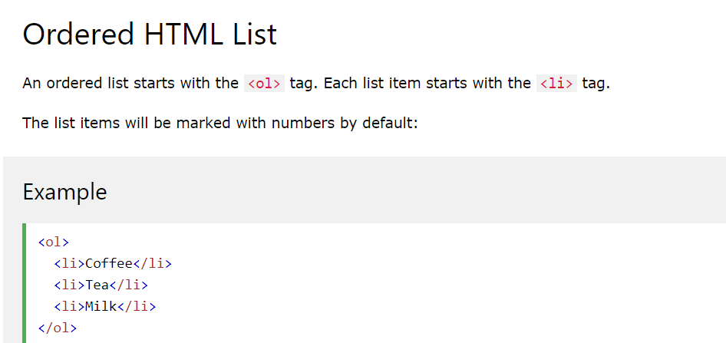

Slide 3
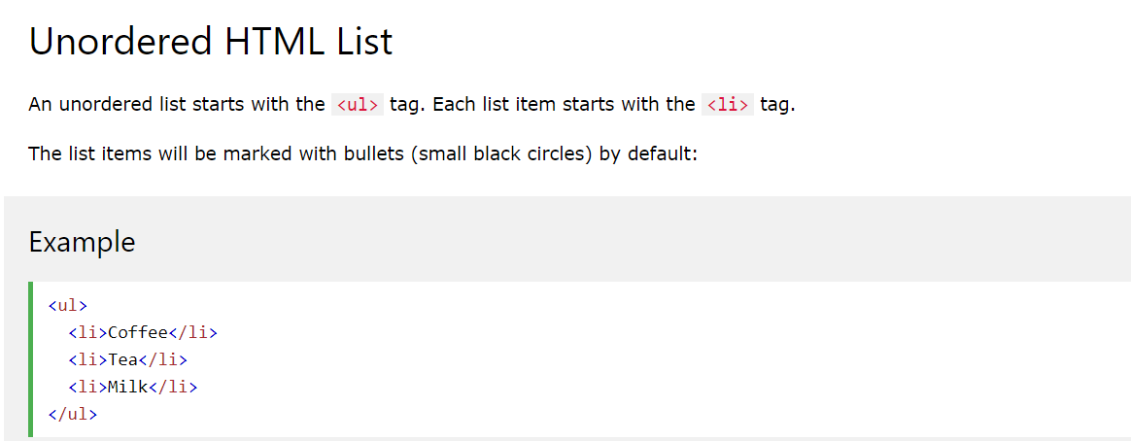

Slide 4
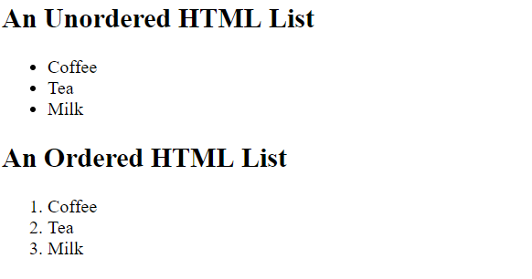
Create this output using HTML code

Slide 5
TEST yourself!!
Create a web page : using ordered and unordered HTML lists

